Slide 1
Unit 2: What is NIMS?
Unit 2:
What is NIMS?

Slide 2
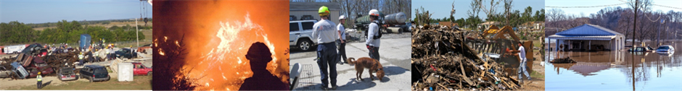
Unit Terminal Objective
Explain the National Incident Management System.

Slide 3
Unit Enabling Objectives
  Describe the National Incident Management System (NIMS).
  Summarize the NIMS Command and Coordination Systems.

Slide 4
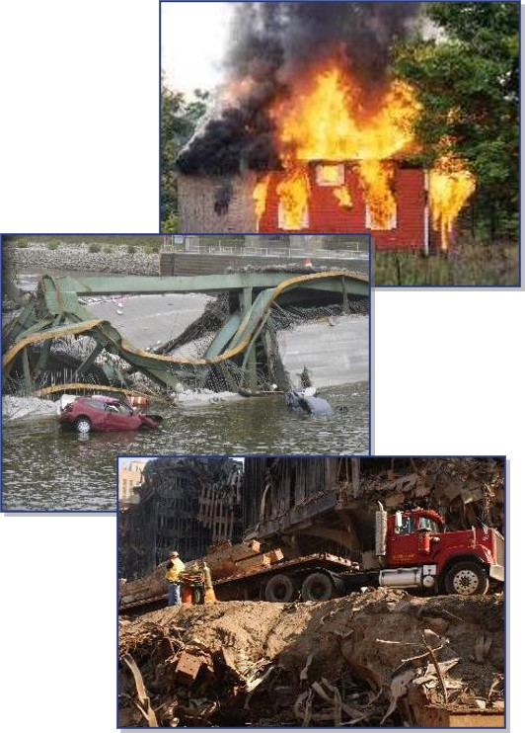
What is an Incident?
An incident is an occurrence, caused by either human or natural phenomena, that requires response actions to prevent or minimize loss of life, or damage to property and/or the environment.

Slide 5
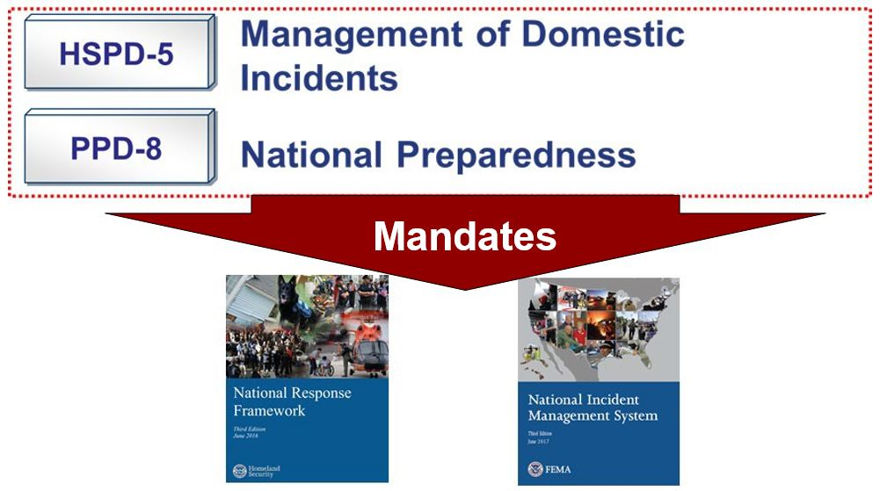
Legal Basis for NIMS

Slide 6
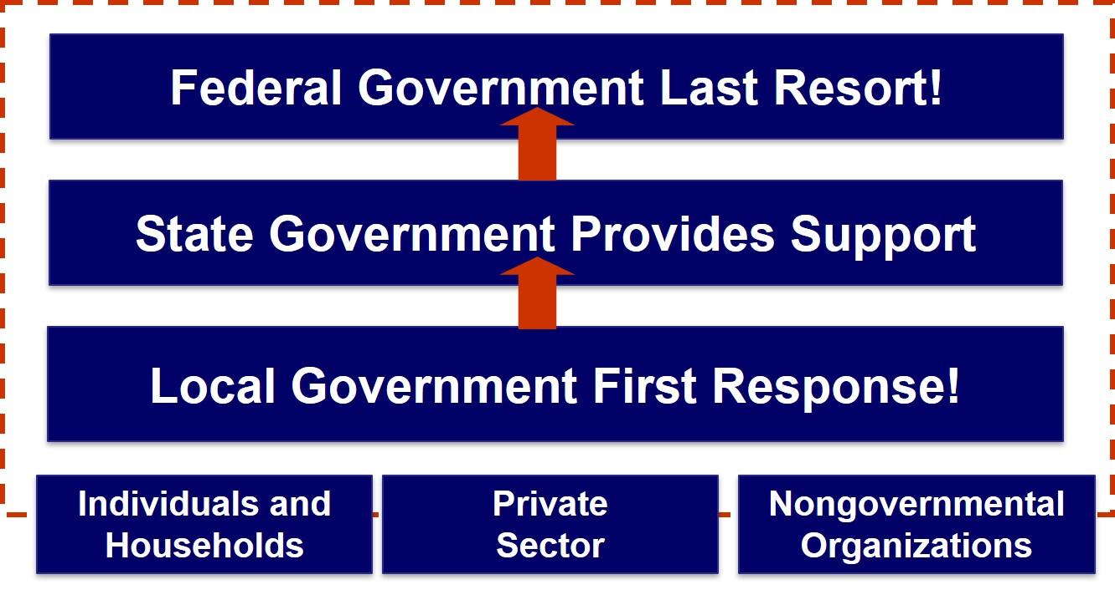
NRF Emphasizes Partnerships

Slide 7
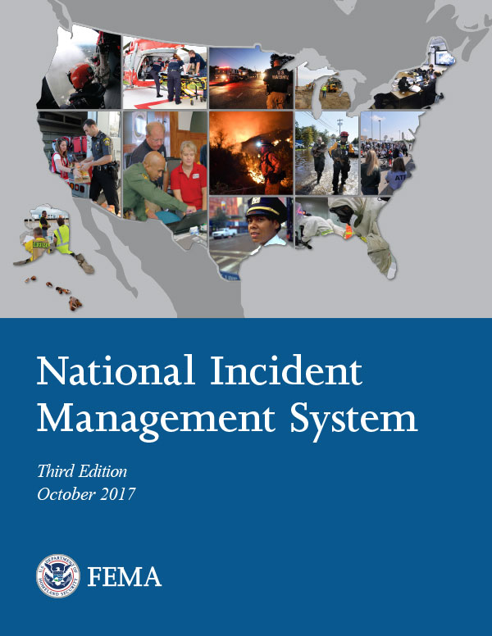
National Incident Management System
  What? . . . NIMS provides a consistent nationwide template . . .
  Who? . . . to enable Federal, State, Territorial, tribal, and local governments, the private sector, and nongovernmental organizations to work together . . .
  How? . . . to prepare for, prevent, respond to, recover from, and mitigate the effects of incidents regardless of cause, size, location, or complexity . . .
  Why? . . . to reduce the loss of life and property, and harm to the environment.

Slide 8
NIMS: What It Is/What It's Not
NIMS Is | NIMS Is Not
A comprehensive, nationwide, systematic approach to incident management, including the command and coordination of incidents, resource management, and information management | Only the ICS Only applicable to certain emergency/incident response personnel A static system
A set of concepts and principles for all threats, hazards, and events across all mission areas (Prevention, Protection, Mitigation, Response, Recovery) | A response plan
Scalable, flexible, and adaptable; used for all incidents, from day-to-day to large-scale | Used only during large-scale incidents
Standard resource management procedures that enable coordination among different jurisdictions or organizations | A resource-ordering system
Essential principles for communications and information management | A communications plan

Slide 9
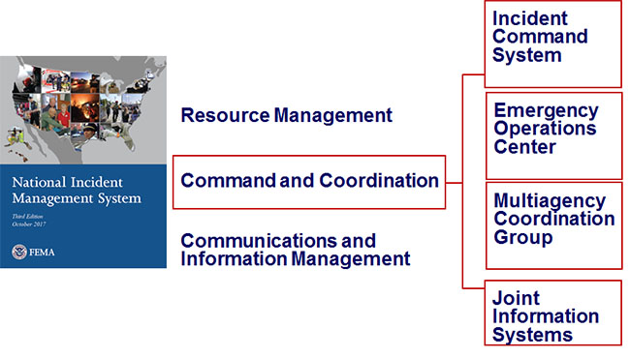
NIMS Components

Slide 10
National Incident Management System
Command: The act of directing, ordering, or controlling by virtue of explicit statutory, regulatory, or delegated authority.
Who has the EXPLICIT authority for the management of all incident operations?

Slide 11
National Incident Management System
Multiagency coordination is a process that allows all levels of government and all disciplines to work together more efficiently and effectively.

Slide 12
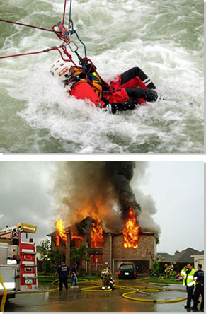
Multiagency Coordination Groups
During incidents, MAC Groups:
  Act as a policy-level body.
  Support resource prioritization and allocation.
  Make cooperative multi-agency decisions.
  Enable decision making among elected and appointed officials with those managing the incident (IC/UC)

Slide 13
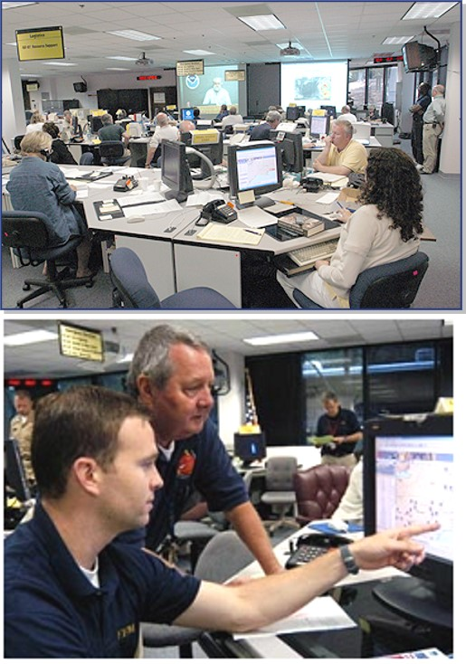
Emergency Operations Centers
EOCs are physical or virtual locations where staff, stakeholders, and partners gather to provide support for an incident.

Slide 14
Joint Information System
JIS activities include:
  Coordinate interagency messaging.
  Develop public information plans and strategies.
  Advise the IC and EOC Director on public affairs issues.
  Control rumors and inaccurate information.

Slide 15

Incident Command System
  Standardized approach to on-scene command, control, and coordination.
  Common structure where personnel from different organizations work together.
  Structure for incident management that integrates and coordinates procedures, personnel, equipment, facilities, and communications.

Slide 16
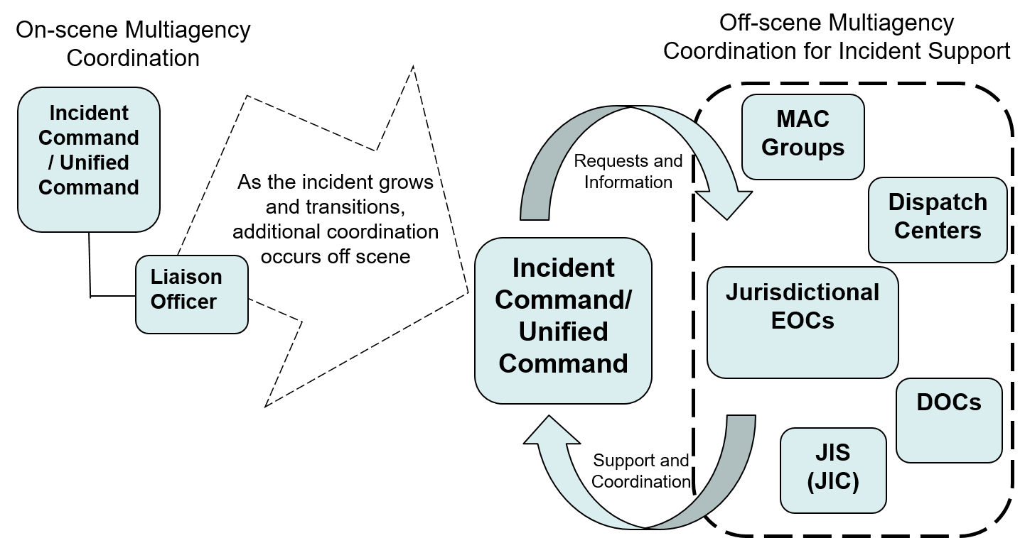
Interconnectivity of NIMS Command and Coordination

Slide 17
Overview of the Senior Officials' Role
In most jurisdictions the Senior Official is responsible for:
  Ensuring the safety of the citizens and protection of property
  Ensuring the continuity of government
  Activating specific legal authorities (disaster declarations, evacuations, state of emergency, or other protective actions)
  Delegating Authority for Incident Command to an IC/ UC
  Coordinating with the PIO to keep the media and public informed
  Requesting assistance from State agencies through the EOC
  Resolving any resource allocation conflicts
  Coordinating with other Sr. Officials & whole community partners
  Participating in a Multiagency Coordination Group (MAC)

Slide 18
Objectives Review
  What is NIMS?
  What are the NIMS Command and Coordination Systems?

